Slide 1
Control
Control

Slide 2
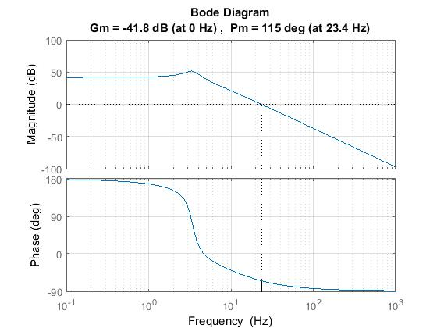
Loopshaping
3Hz
Poles coming from the cart dynamics.
We would like to cancel this behavior.

Slide 3
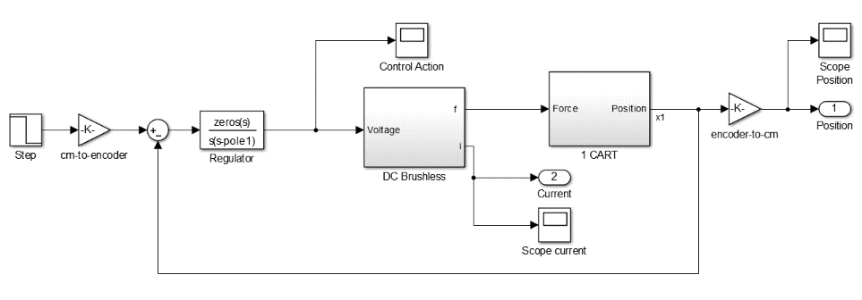
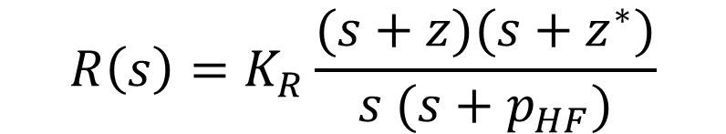
Loopshaping
cancel out cart dynamic
$$R\left(s\right)=K_{R}\frac{(s+z)(s+z^{∗})}{s (s+p_{HF})}$$
Integral action
causal block

Slide 4
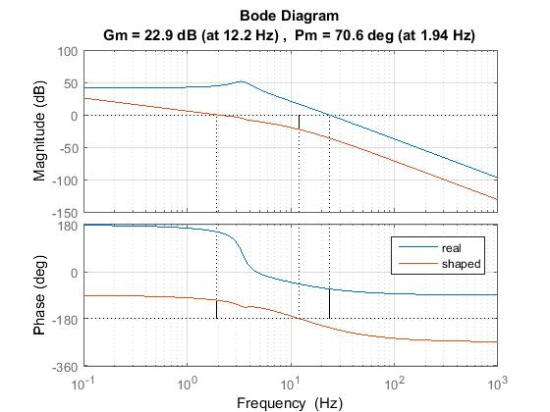
Loopshaping

Slide 5
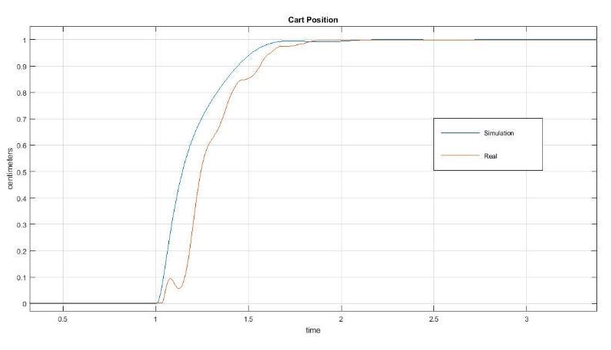
Loopshaping
Transient does not take into account non-linearities,
but rising time and steady-state value match what we expected.

Slide 6
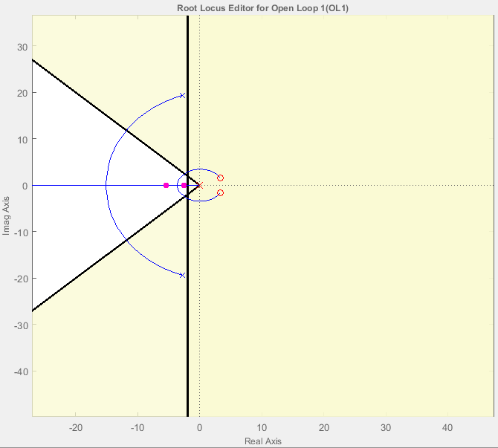
Positive zeros
What if there is another helpful position for the zeros of the regulator?
Admissible Area wrt Performance
Cart Poles

Slide 7
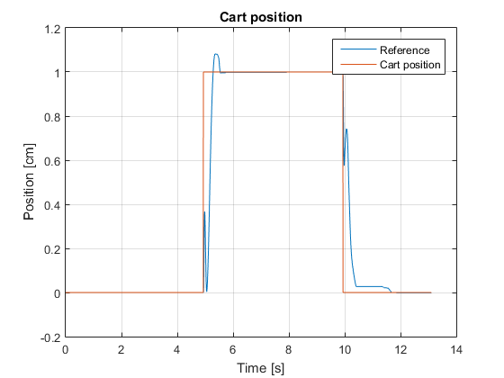
Positive zeros

Slide 8
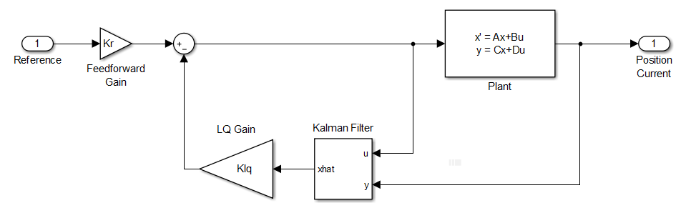
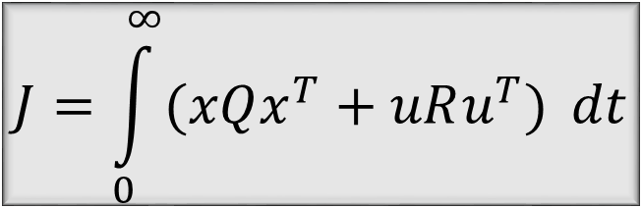
LQG
$$J=\int_{0}^{∞}{(xQx^{T}+uRu^{T})} dt$$
computed in order to guarantee zero tracking error at steady-state.
Notes:
LQG is a state-feedback controller => Kalman.
How do we weight Q and R?
Why didnt we include an integral action.

Slide 9
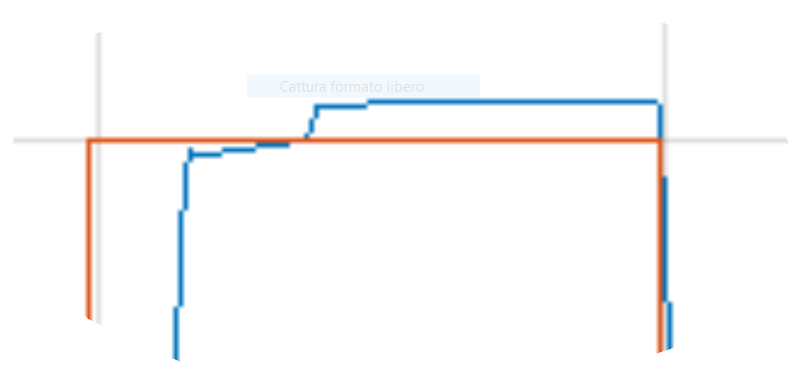
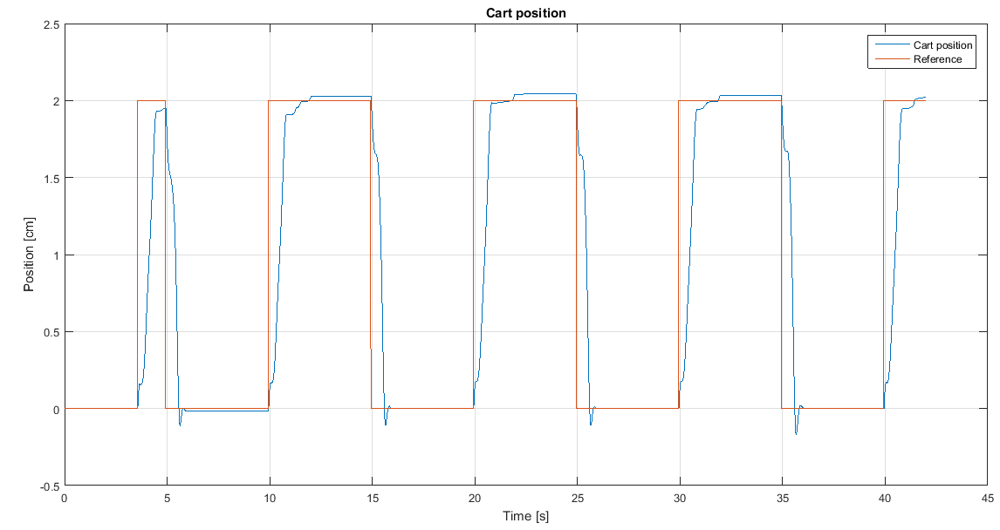
LQG
The compensator is not perfect even though error is below 1/100.

Slide 10
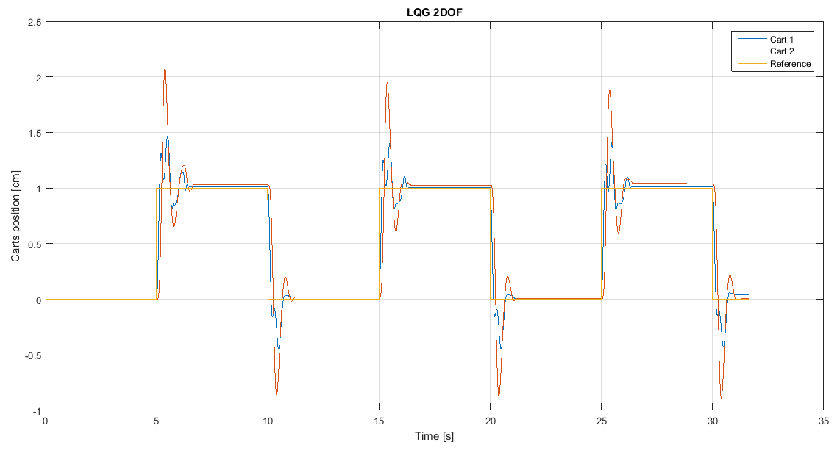
LQG 2dof

Slide 11
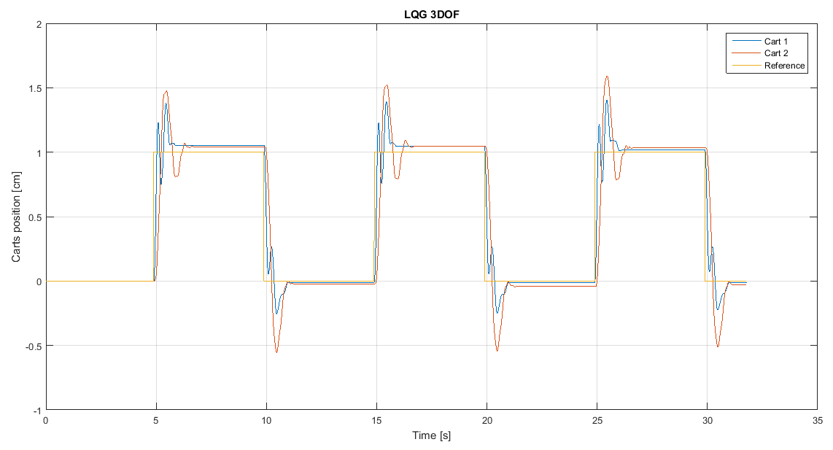
LQG 3dof

Slide 12
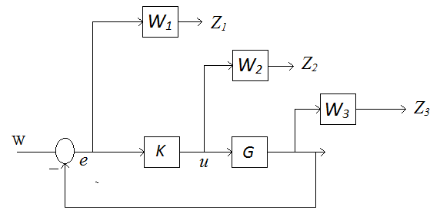

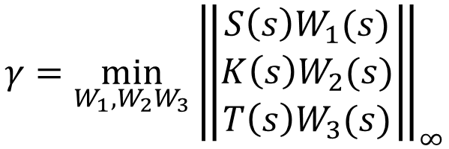
$$H_{∞}$$
$$γ=\min_{W_{1},W_{2}W_{3}}{{\left\|\begin{aligned}S\left(s\right)W_{1}(s) \\ K\left(s\right)W_{2}(s) \\ T\left(s\right)W_{3}(s)\end{aligned}\right\|}_{∞}}$$

Slide 13
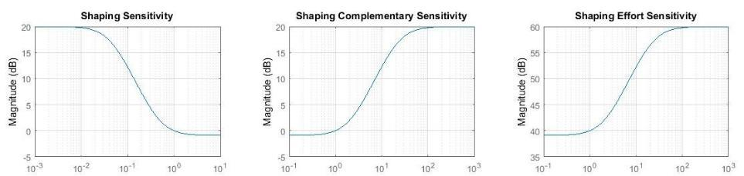
$$H_{∞}$$
1Hz
The weights should have the inverse shape of the desired sensitivity.
The higher the weight the weaker the control action:
It is important since the motor saturates at ±5V.

Slide 14
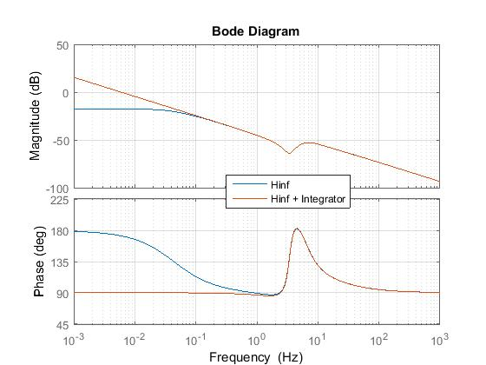
$$H_{∞}$$

Slide 15
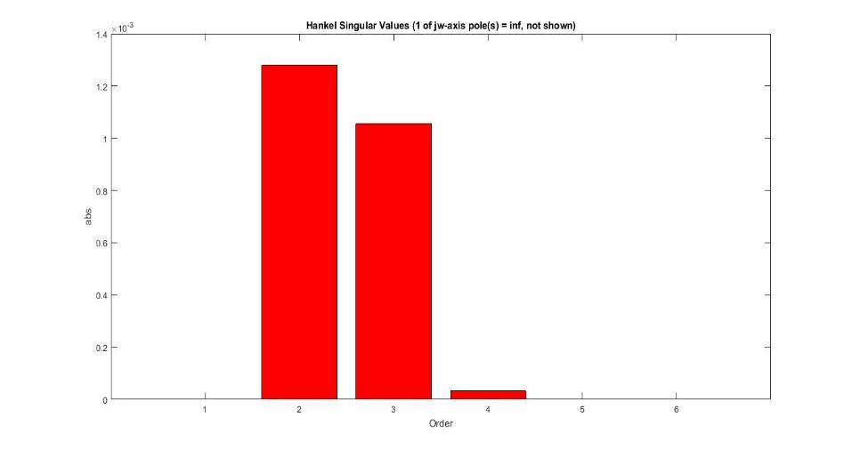
$$H_{∞}$$
Reducing the order of complexity of the regulator does not alter perfomance.

Slide 16
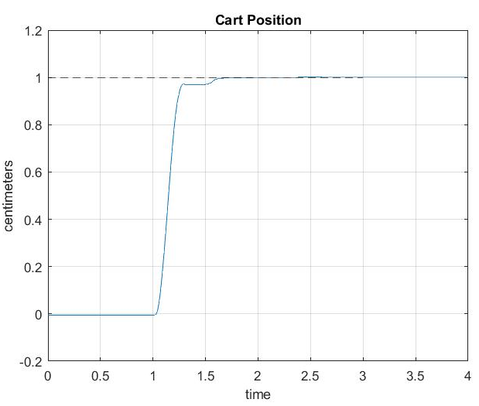
$$H_{∞}$$
Zero tracking error
Rising time less than 1 sec
Noise cancellation

Slide 17
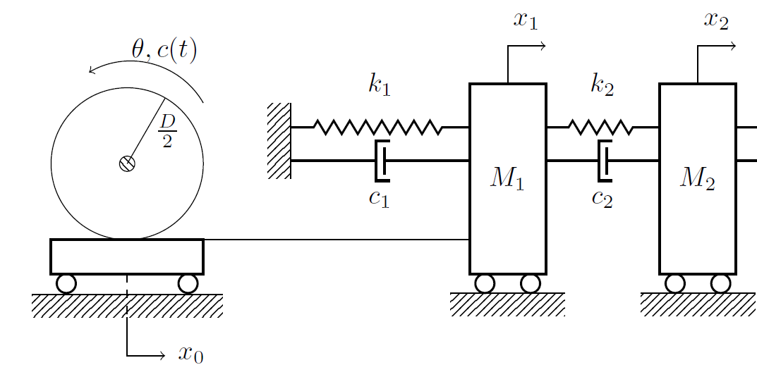
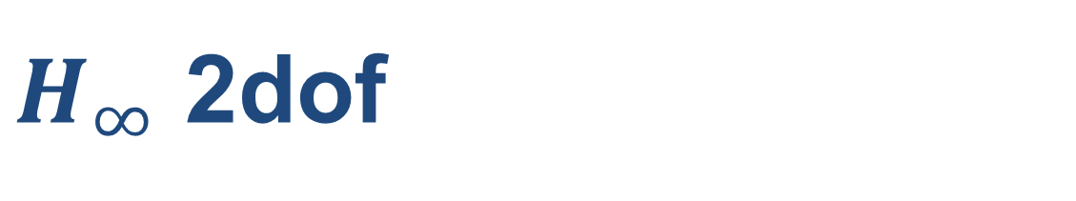
$H_{∞}$ 2dof
Notes:
We feedback from the second output

Slide 18
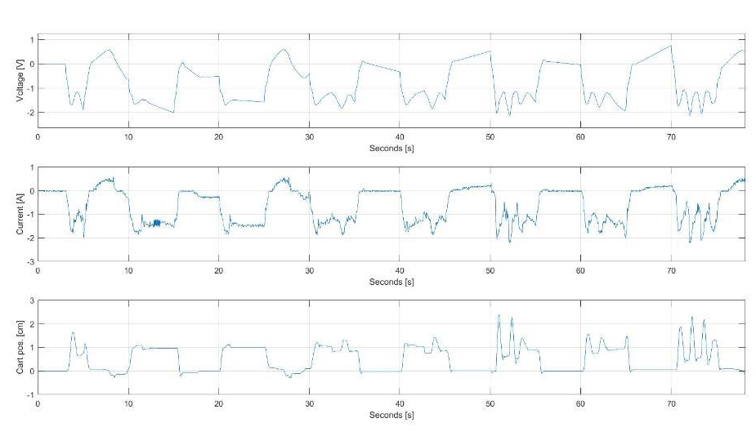
$H_{∞}$ 2dof

Slide 19
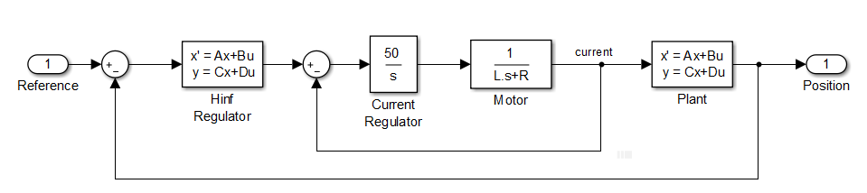
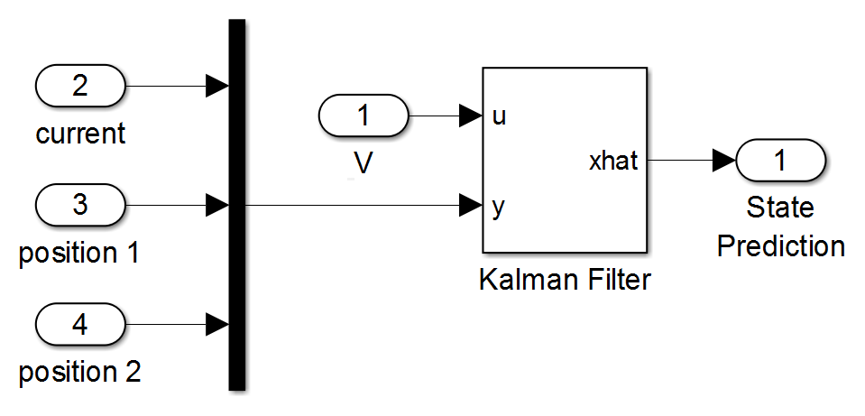
$H_{∞}$ 2dof
The current is not directly measured, but estimated through a Kalman filter.
The current regulator allows to stabilize the motor effort.

Slide 20
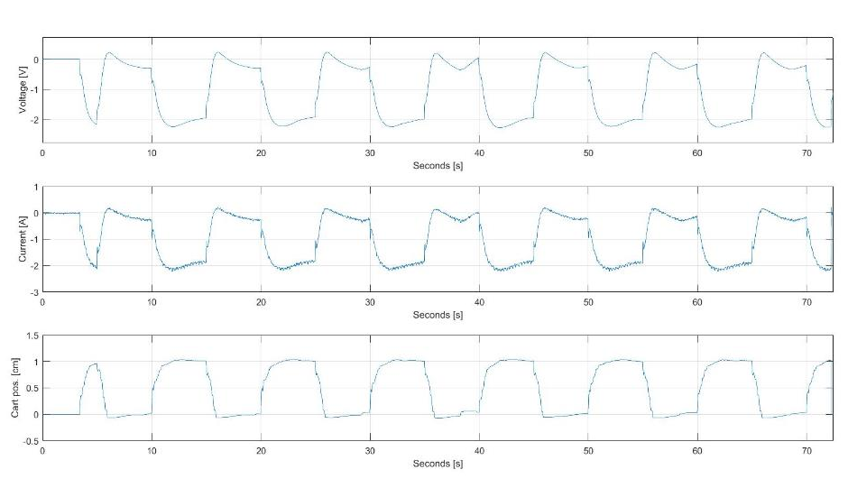
$H_{∞}$ 2dof

Slide 21
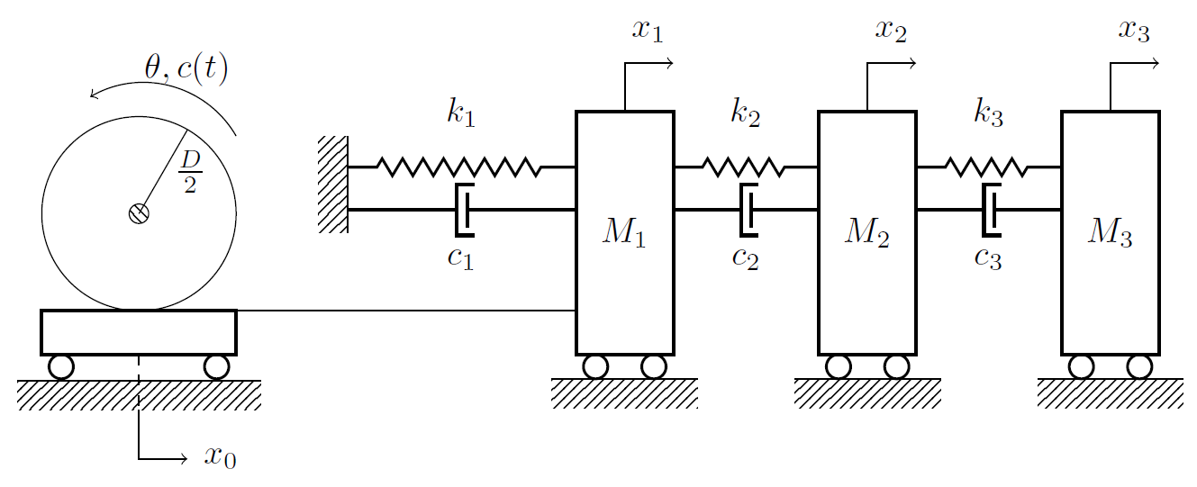
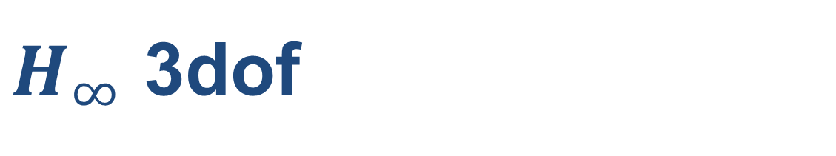
$H_{∞}$ 3dof

Slide 22
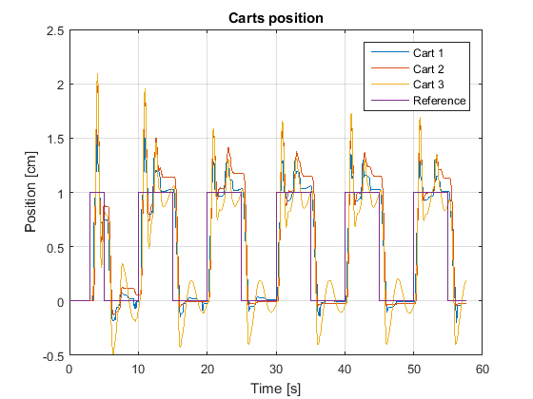
$H_{∞}$ 3dof
The response (although not perfect) is way more stable with the inner current loop.

Slide 23
EKF
Extended Kalman Filter

Slide 24
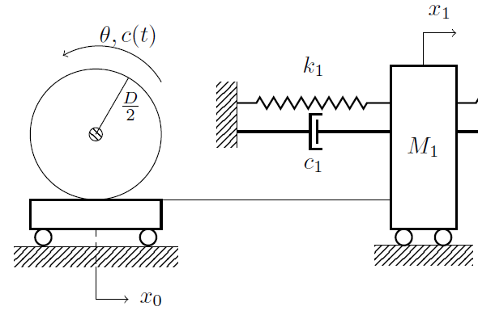
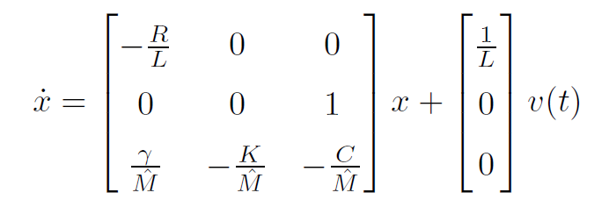
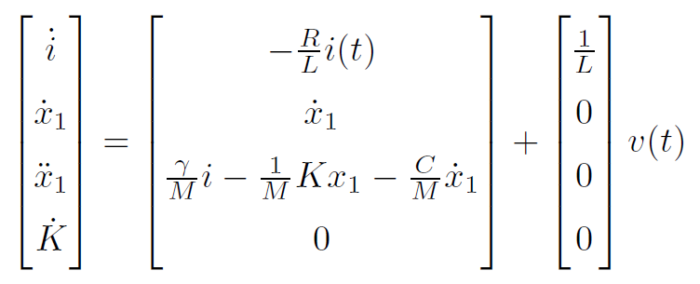
EKF
Linear Model
Nonlinear Model

Slide 25
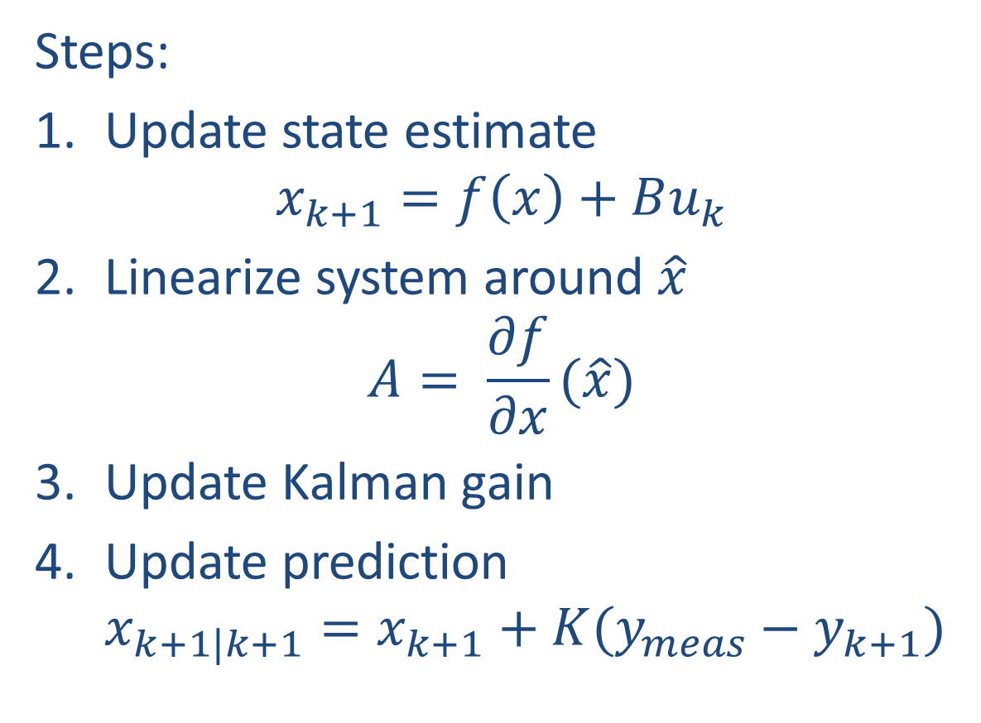
EKF
Steps:
Update state estimate $x_{k+1}=f\left(x\right)+Bu_{k}$
Linearize system around $\hat{x}$ $A= \frac{∂f}{∂x}(\hat{x})$
Update Kalman gain
Update prediction $x_{k+1|k+1}=x_{k+1}+K(y_{meas}−y_{k+1})$
Notes:
Discrete time because it works better.
There is no implementation of EKF on matlab.

Slide 26
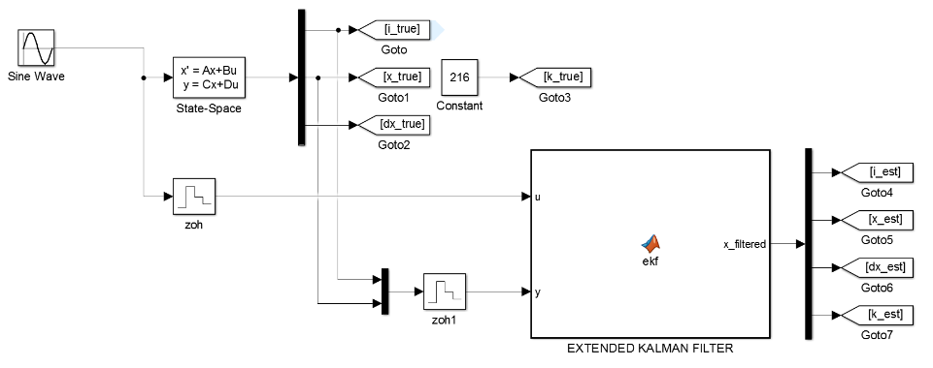
EKF
Simulink simulation
Porting onto Arduino
Validation of results
Notes:
Correctness of implementation
Noisy data, Online
Comparing Arduino vs Simulink = Online vs Offline

Slide 27
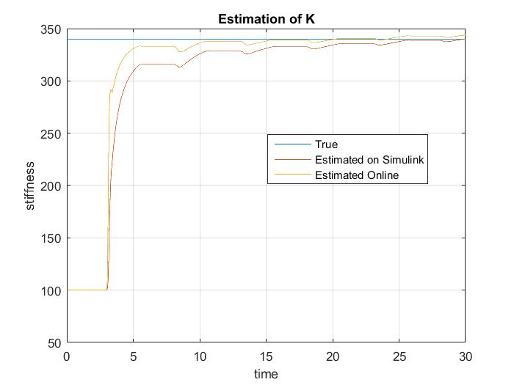
EKF

